Slide 1

Viability of bee brood (Apis mellifera) for curl bee brood additives to boost chicken feed ingredient for enhanced food security
Nuwemuhwezi Gershom
A461/4320/2018
JOOUST

Slide 2
OUTLINE
Statement of the Problem
Objectives
Research Questions/Hypotheses
Material and Methods
Expected outcomes
Budget
Work plan
Acknowledgement
References

Slide 3
STATEMENT OF THE PROBLEM
Edible stages of honey bee are brood of Queen, workers and drone (larvae, pupae) (Antoine& Annette, 2018).
Honey bee (Apis mellifera) facilitates pollination and production of honey, brood for food in aspects of substituting conventional protein sources like soya bean, fish meal,Black solider fly(Annette,2018;Evans,2018). In terms of being low cost or better because of being more nutritive.

Slide 4
Cont’d
Current practice of culling bee brood is the effective measure of varroa mite control when combined with chemical treatment as part of an integrated pest managing strategy (Calderone, 2005; Annette, 2018).
This has led to wide-spread adoption of this methods in Denmark& European countries.
However, beekeepers in Africa are ignorant& have no knowledge at the efficacy and adoption of one complex IPM tool cull bee brood(CBB) &
How to utilize and integrate culled bee brood into their food or feed systems after processing as an alternative source of protein.

Slide 5
Cont’d
However, the extent of this new adoption widely spread is currently unknown in Africa.
This study therefore intends to Investigate viable methods of culling Bee brood (CBB) for use as alternative chicken feed additives for improved feed systems;
that is, it’s edible potential of honey bee(Apis mellifera) brood now and future as alternative source of protein.

Slide 6
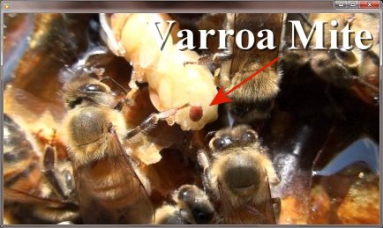
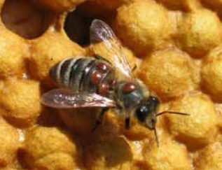
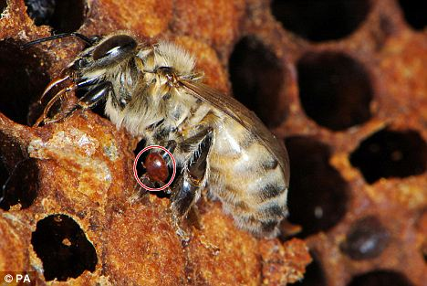
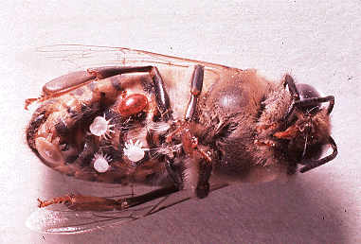
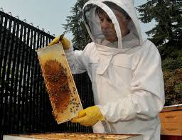
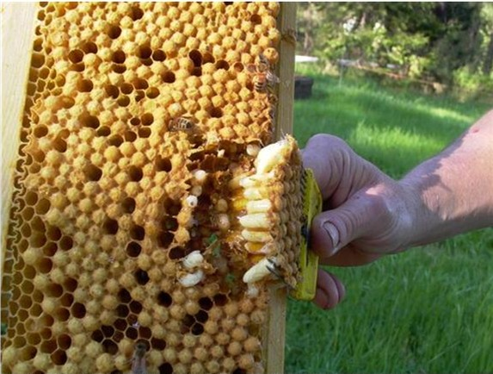
Pictorial representation
Worker bee& mites varroa
Dead worker bee
Mite on larva
Source: (Annette, 2018)
Source: presenter
Source: www.sde.co.ke
Source: www.dnbstories.com
Kirsten,2018

Slide 7
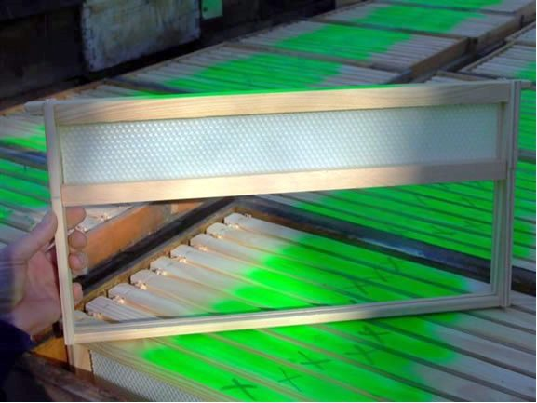
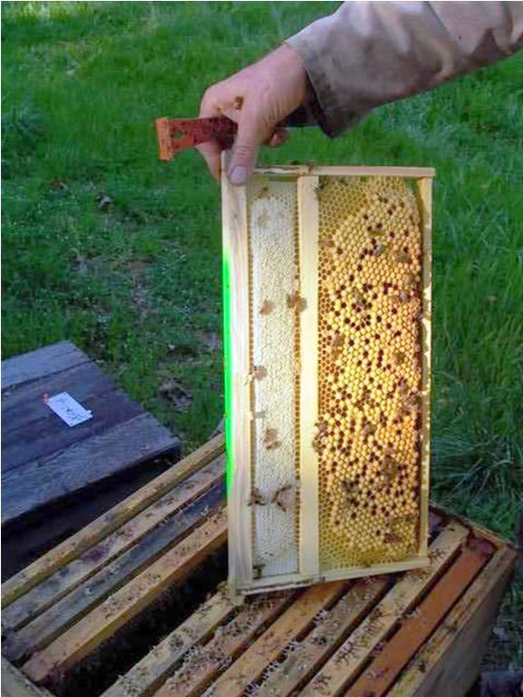
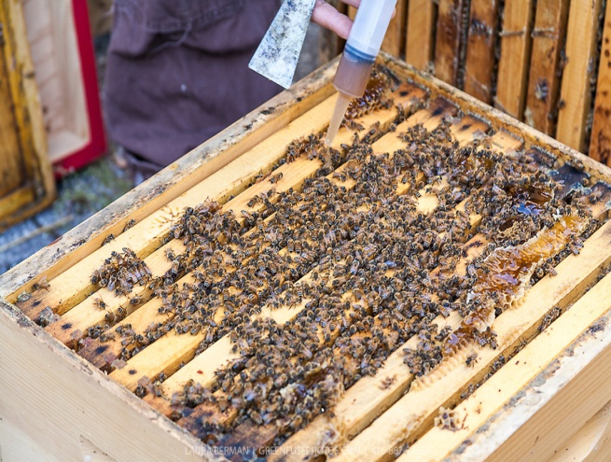
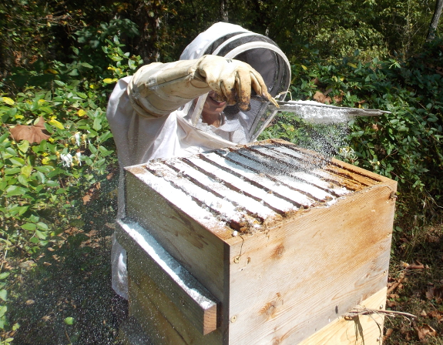
Cont’d
Photo Oliver drone trap frame frame & drone trap frame after 4 weeks.2019

Slide 8
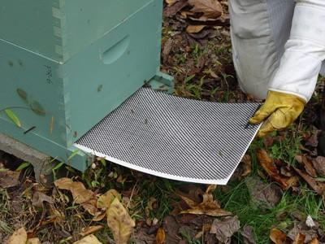
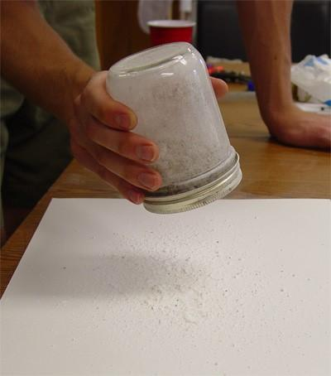
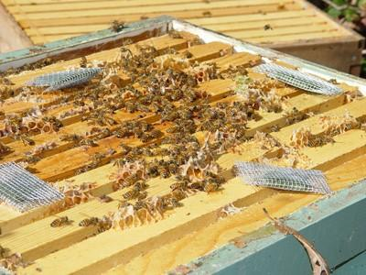
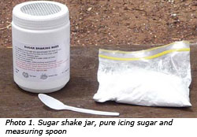
Controlling Varroa Mites
VarroaFacts
whitehead, 2016
Screen bottom board

Slide 9
OBJECTIVES
General Objective
To investigate a viable method of culling Bee Brood(Apis mellifera) for use as an alternative chicken feed additive for improved livelihoods.

Slide 10
Specific objectives
To identify factors influencing availability of bee brood as an alternative source of proteins in chicken feed.
2. To evaluate the most appropriate methods for controlling mite by culling out drone & worker brood.
3. To determine the most cost effective option for integrating curl bee brood as chicken feed additives for improved food security among chicken farmers

Slide 11
Specific objectives
4. To develop strategies for increased adoption of curl bee brood as an alternative chicken feed additive for increased poultry production and improved livelihoods in western Uganda.

Slide 12
Research Questions 1 and 4.
Is there a major factor influencing viability of bee brood additives in chicken feeds?
4. Are the beekeepers and chicken farmers willing to adopt curl bee brood into chicken feeds as an alternative additive?
Hypotheses 2 and 3.
2. Mechanical method for controlling mite by culling out affected bee brood is not effective.
3. Weight difference of chicken fed on feed with curl bee brood additives and those fed on normal feed are statistically insignificant.

Slide 13
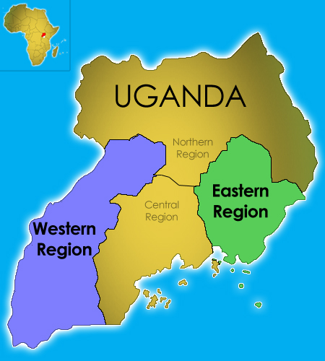
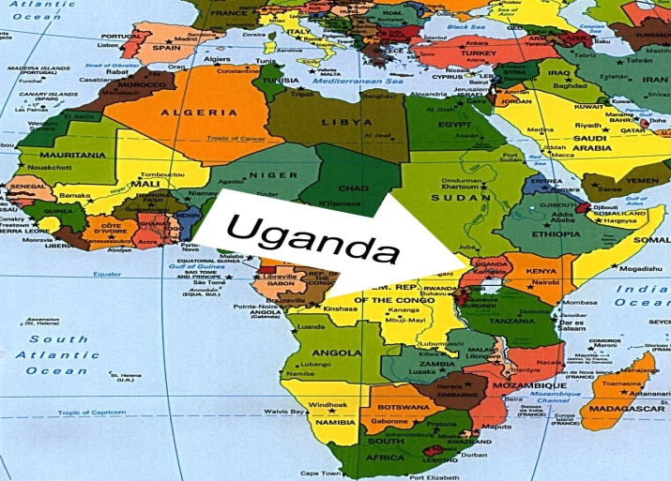
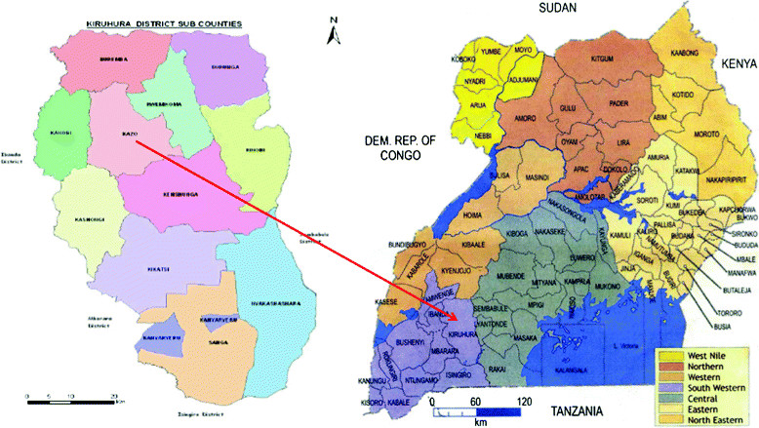
MATERIAL AND METHODS
OBJECTIVE 1
Study site( with incidences in decline bee colonies population)
Location of Mbarara in Western region, Uganda
Coordinates: 00°39′S 030°41′ECoordinates: 00°39′S 030°41′E
c
A survey will be conducted in 46 apiary sites from each site researcher will sample 7 colonies from each apiary among 3 districts of Western Uganda.
Mbarara
Kiruhura
Sheema

Slide 14

Cont’d – objective 1- Survey
Sample size.
The sample size is determined by the William Godden formula (2004) which allows for estimation of the sample size without the knowledge of the population.
It is given by:
Where:
n = Sample Size for infinite population
Z = Z value (e.g. 1.96 for 95% confidence level)
P = population proportion (expressed as decimal) (assumed to be 0.1 (10%) since this would provide the maximum sample size).
M = Margin of Error at 5% (0.05)
For the case of the study sample size will be determined as follows:
n = 1.96²x0.1 (1-0.1) / 0.05² = 0.345744÷0.0025 = 138.2976.
The sample size for the study will therefore be 138 Bee keepers& officials from 3 district of western region of Uganda..

Slide 15
Cont’d – objective 1- Survey
Sampling criteria
A Proportional Random Sampling criterion will be done.
The earlier 7 colonies from each 46 respondent sampled from each District will be the strata
Proportions will be determined after a pilot test.
District | Population (Census 2014) | Sample size (@ district respondents) | Number of colonies to be inspected | Total sampling of colonies at each District
Sheema | 207,343 | 46 | 7 | 322
Mbarara | 472,629 | 46 | 7 | 322
Kiruhura | 328,077 | 46 | 7 | 322
Total | 1,008,049 | 138 | 21 | 966

Slide 16
Cont’d – objective 1&4- Survey
Ethical consideration
Clearance – presented before faculty panelists
Awareness – Purpose of the study will be explained to respondents including their ability to withdraw
Consent – Informed consent shall be sought from the participants and relevant beekeeping authorities
Anonymity & confidentiality – Names of the respondents will be omitted during reporting
Validity & reliability – clear questionnaires will be developed and piloted before administering.

Slide 17
Cont’d – objective 1- Survey
QUESTIONNAIRE SECTIONS
A : Demographics(colonies)
B : Knowledge on use of bee brood as feed to their chicken, cultural briefs, perceptions, challenges.
C : Methods of controlling varroa mites
D : Willingness to adoption of new mechanical method of controlling mites
Data Analysis
Descriptive and inferential statistics will be performed on the data.
R-studio and Excel Packages will be used for the Analyses

Slide 18
Cont’d – objective 2
Mechanical method of controlling varroa mite.
On- farm Trial Experiment
Setting up apiary farm at Kashongi with 10 (ten) colonies.
Select control or treatment colony randomly.
The control colonies will receive regular brood frames,
Treatment colonies will receive cull brood removal after 2 weeks.
Two frames will be inserted into each colony near the center of the box in the brood chamber to encourage the laying of eggs rather than the bees using the frames to store honey or pollen.
The first frame will be inserted in the fourth frame position of the colony

Slide 19
Frame 1 will be removed
1 | 2 | 3 | 4 | 5 | 6 | 7 | 8
1 | 2 | 3 | 4 | First frame | 5 | 6 | 7 | 8

Slide 20
Cont’d – objective 2
Frames will be numbered going left to right when standing at the entrance of the hive. (1,2,3,4,5,6,7,8.).
On the first day of treatment, frame 1 will be removed and first research frame (either a treatment or control frame) will be inserted in between the fourth and fifth frame.

Slide 21
Frame 2 will be removed
1 | 2 | 3 | 4 | First frame | 5 | 6 | 7 | 8
1 | 2 | 3 | 4 | First frame | Second Frame | 5 | 6 | 7 | 8

Slide 22
Cont’d – objective 2
Frames will be numbered going left to right when standing at entrance of the hives.
Seven days after the first insertion, frame two will be removed, all the frames except the first will be inserted frame will be shifted over and second research frame(treatment control will be inserted in between the first frame and the sixth frame.
Seven days after, second frame will be inserted in the fifth frame position (figure 4). Twelve days after a frame will be inserted will be removed and inspected. If it will be fully capped with drone larvae, then will be removed. If not, it will be left in hive and checked at a later date.
In this case no frame will be left in the colony for more than twenty days(figure 1). The timeline of when frames will be inserted or removed, and when alcohol washes will be conducted.

Slide 23
Cont’d – objective 2(3 sampling)
Day 0 | Day 7 | Day 12 | Day 19 | Day 20 | Day 27
First frame is inserted | Second frame is inserted | Check first frame | -Check second frame. -First day to perform an alcohol wash. | All first frames must be removed. | -All second frames will be removed. -last day to perform an Alcohol wash.

Slide 24
Cont’d – objective 2
The insertion of frames will stagger to avoid removing too much brood from the colony at once. This will be performed on each colony before the first trial in specific month.
A trial will begin with the insertion of the first frame and end with the removal of the second frame. Three trials of cull bee brood removal will be conducted across the season.
Seven (7) bee hives will be visited at each apiary farm at the beginning of the season and end of the season.
Beekeepers will not be asked to follow any specific beekeeping procedures, but their methods of mite control will be recorded.
They either treats their colonies for mites, treated with cull bee brood removal or any other methods this will set baseline study

Slide 25
Cont’d – objective 3 curl brood feed additives trials experiment
3×3 factorial experimental design will be set.
Brood removal, Sampling capped frames and Sampling 2 weeks are the factors.
Each Factor has 2 Levels.
Sampling will be replicated twice.
Intrinsic parameters
Sample capped frame , eggs, larvae and pupae with varroa mite population will be determined by testing All experimental for equality of variance and normality of
residuals

Slide 26
Cont’d – objective 2
Data Analysis
R-studio & Microsoft Excel Packages
Shapiro- Wilk test and Bartlet tests will be performed to test for normality and Variance homogeneity respectively and variance.
Homogeneity for equality of variance and normality of residuals. Data will be log transformed (log₁₀(x+1)) because they will count-data.
heterogeneous ,variances (Bartlett: p=0.00098, Transformed Bartlett: p=0.2721). Mite data from similarly transformed (log₁₀(x+1)).
One-way and two-way, ANOVAs will be conducted to test the effect of treatment Culling Bee Brood (CBB) or control) on mite levels.

Slide 27
Cont’d – objective 2
Data Analysis
Location will be used as a blocking factor; otherwise it will be left out of the model.
Tests will be conducted on mite data from the first and last sampling dates.
Repeated-measures MANOVA will also be conducted for all dates to test the effect of Culling Bee Brood(CBB) on mite levels.
Data from first season and second season are not transformed (Bartlett: p=0.4101 and Bartlett: p= 0.1246, respectively).

Slide 28
Cont’d – objective 2
Data Analysis
Two-way and one-way ANOVAs will be conducted to compare the effect of Culling Bee Brood(CBB) on hive size.
Tests will be performed for SEAM Open Data draws from the work of the SEAM Phase I and Time Lapse Pilot projects to make small proprietary data sets available free of charge to the public to advance research and innovation in geophysics.
on the first and last sampling dates.

Slide 29
Cont’d – objective 3
Effect of using curl bee brood as alternative source of proteins in chicken feeds.
Experimental Design
A CRD will be set.
Treatments – 3 feeding trials
Treatment will be replicated thrice, response will be live weight gain, growth rate, consumption rate.

Slide 30
Cont’d – objective 3
Data Analysis
R and Microsoft excel packages will be used
Shapiro- Wilk & Bartlett’s tests will be used to confirm ANOVA assumptions of normality.
One way ANOVA test the hypothesis on chicken feed additives have the same effect on the similar chicken breed. Results will be presented in graphs and tables.

Slide 31
Cont’d – SUMMARY
OBJECTIVES | STUDY AREA | STUDY POPULATION | SAMPLING CRITERIA | STUDY DESIGN
Identify common trader food safety and hygiene practices of edible termites in open air markets. | Kiruhura,Mbarara,Sheema Western Uganda Africa | Commercial and small scale beekeepers in the region experiencing bee colonies loss | A Stratified Random Sampling | Survey Design
Prevalence of microbial load in Open air traded edible termites. |  |  | Three (46) beekeepers will be randomly selected from each district. | Factorial Design
Efficacy of common postharvest processing practices in microbial load reduction. |  |  | Chicken will fed on commercial feed, bee brood and commercial with curl bee brood as additives subjected to 3 feeding substrate as (treatments) | Complete Randomized Design

Slide 32
Cont’d – SUMMARY
OBJECTIVES | STUDY AREA | STUDY POPULATION | SAMPLING CRITERIA | STUDY DESIGN
Identify common trader food safety and hygiene practices of edible termites in open air markets. | Kiruhura,Mbarara,Sheema Western Uganda | Commercial and small scale beekeepers in the region experiencing bee colonies loss | A Stratified Random Sampling | Survey Design
Prevalence of microbial load in Open air traded edible termites. |  |  | Three (46) beekeepers will be randomly selected from each district. | Factorial Design
Efficacy of common postharvest processing practices in microbial load reduction. |  |  | Chicken will fed on commercial feed, bee brood and commercial with curl bee brood as additives subjected to 3 feeding substrate as (treatments) | Complete Randomized Design

Slide 33
Expected outcomes
Impact the future of agriculture in a way of contributing to food and nutritional security.
Develop new method of mites’ control that are efficient and inexpensive.
Edible insects (Apis mellifera) will play role as protein industries change in the face of climate change and population growth.
As a means to reduce green emissions, people will turn to edible , among (Apis mellifera )other types of sustainable proteins, and the industry will continue expanding.

Slide 34
Cont’d
New bi-products of honey bee through utilization and formulation of chicken feed additive from bee brood known as curl brood Additives
Evaluate whether use cull bee brood as an edible insects as chicken farmers use of processed cull bee brood into their feeding regime as curl brood additives.
Create new investment opportunities through selling culled bee brood as essential incentives for beekeepers, something that has never been done before here in Africa.

Slide 35
Cont’d
Provide a means that beekeepers can make extra money off from mechanical method of mite control in addition to keeping their bees healthy.
Processing and utilization of culled bee brood will continue to expansion of edible insects industry and possible benefits both apiary and poultry industries, if they choose to work together.
Intersecting fields, such as beekeeping and entomophagy, as a way to encourage more sustainable agriculture systems in order to prevent overexploitation of singular system, which will likely harm the organisms involved.
Re-examine our agriculture industry to find ways to reduce our greenhouse gas emissions, be more sustainable, and protect the health of bees within the agricultural fields.

Slide 36
RESEARCH SUMMARY BUDGET in Ksh
ACTIVITY | QUANTITY | RATE (KSHS.) | TOTAL (KSHS.)
Concept and Proposal Development |  |  | 179,920
Equipment and Tools |  |  | 78,000
Data Collection |  |  | 250,830
Pilot Study |  |  | 59,000
Thesis Preparation |  |  | 45,800
Contingencies(10%) |  |  | 61,355
Grand-Total |  |  | 674,905

Slide 37
BUDGET- in Ksh
ACTIVITY | QUANTITY | RATE (KSHS.) | TOTAL (KSHS.)
Concept and Proposal Development
Stationery
Notebooks | 5 | 280 | 1,400
Pens | 1 | 720 | 720
Flashdisks(2GB) | 1 | 1000 | 1,000
Internet |  |  | 20,000
Airtime |  |  | 2,500
Recorders | 1 | 11800 | 11,800
Spring files | 4 | 50 | 200
Sub-Total |  |  | 37,620

Slide 38
BUDGET- in Ksh
Typesetting ,editing &Printing | 200 | 30 | 6,000
Photocopying | 600 | 5 | 3,000
Binding(loosely) | 8 | 100 | 800
Transport(local-days) | 150 | 600 | 90,000
Subsistence(days) | 30 | 1000 | 30,000
Literature review transport (days) | 5 | 2500 | 12,500
Sub-Total |  |  | 142,300

Slide 39
BUDGET- in Ksh
Equipment and Tools
Bee-hives | 10 | 4000 | 40,000
Protective Clothes | 4 | 7000 | 28,000
Other tools(smokers) | 10 | 1000 | 10,000
Sub-Total |  |  | 78,000
Pilot Study
Piloting Transport | 1 | 15000 | 15,000
Digitization of questionnaires | 2 | 5000 | 10,000
Training Research assistants | 1 | 5000 | 5,000
Transport(local-days) | 5 | 800 | 4,000
Return Flight to Uganda | 1 | 25000 | 25,000
Sub-Total |  |  | 59,000

Slide 40
BUDGET- in Ksh
Data Collection
Produce Interview questionnaires | 5 | 30 | 150
Photocopying questionnaires | 260 | 3 | 780
Subsistence(local-days) | 18 | 1,000 | 18,000
Transport(local-days) | 18 | 800 | 14,400
Transport(research ass.) | 5 | 1,500 | 7,500
Statistical services(papers) | 3 | 40,000 | 120,000
Publication Fee | 3 | 30,000 | 90,000
Sub-Total |  |  | 250,830

Slide 41
BUDGET- in Ksh
Thesis Preparation
Editing and Printing(copies) | 180 | 30 | 5,400
Photocopying(coloured copies) | 900 | 20 | 18,000
Binding(copies) | 7 | 400 | 2,800
Transport(local-days) | 4 | 1,000 | 4,000
Final Binding(copies) | 8 | 1,200 | 9,600
Subsistence(days) | 6 | 1,000 | 6,000
Sub-Total |  |  | 45,800
Contingencies(10%) |  |  | 61,355
Grand-Total |  |  | 674,905

Slide 42
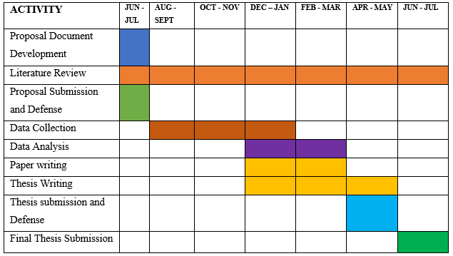
WORK PLAN

Slide 43
REFERENCES
Adjare, S. 1990. Beekeeping in Africa. Food and Agriculture Organization of the United Nations.
Agea, J.G., Biryomumaisho, D., Buyinza, M.,and Nabanoga,G.N.2008.Commercialization of Ruspolia nitidula (nsenene grasshoppers)in Central Uganda. Africa Journal of Food, Agricultures, Nutrition and Development. 8(3), 319-332.
Barennes,H.,Phimmasane,M.,and Rajaonariva,C.,2015.Insect consumption to address undernutrition,a national survey on the prevalence of insect consumption among adults and vendors in Laos.PLOS ONE.10(8).
Blackiston, H.2009.Beekeeping for Dummies (2nd.ed).For Dummies.
Boes, K.E.2010. Honeybee colony drone production and maintenance in accordance with environmental factors: interplay of queen and worker decisions. Insectes Sociaux. 57(1), 1-9
Boot,W.J.,Schoenmaker,J.,Calis,J.N.M.,and Beetsma,J.1995. Invasion of Varroa jacobsoni into drone brood cells of honey bee, Apis mellifera.Apidologie.26 (2), 109-118.

Slide 44
REFERENCES
Bowen-Walker,P.,Martin,s.,and Gunn,A.1999.The transmission of deformed wing virus between honeybees (Apis mellifera L.) by the ectoparasitic mite varroa jacobsoni oud.Journal of invertebrate pathology.73(1),101-106.
Burnham,T. 2016. Varroa bombs are real. Bee culture. 72-74
Calderone, N.W.2005.Evaluation of drone brood removal for management of Varroa destructor (Acari:Varroidae) in colonies of Apis mellifera (Hymenoptera:Apidae) in the north eastern United States. Journal of Economic Entomology. 98(3), 645-650.
CaparrosMegido,R.,Sablon,L.,Geuens,M.,Brostaux,Y.,Alabi,T.,Blecker,C.,DrugmAND,d.,Haubruge,E.,and Francis, F.2014.Edible insects acceptance by Belgian consumers: promising attitude for entompphagy development: could Belgian consumers accept edible insects? Journal of Sensory Studies.29(1),14-20.
Clinton,P, 2016. Should edible insects be regulated like food? The New Food Economy.
Cook,D.C.,Thomas,M.B.,Cunningham,S.A.,Anderson,D.L.,and DeBarro,P.J.2007. Predicting the economic impact of an invasive species on an ecosystem service. Ecological Applications: A publication of the Ecological Society of America, 17(6) 1832-1840.
Crane, E, 1999. The world history of beekeeping and honey hunting. New York: Routledge.
Defoliart, G. 1989. The human use of insects as food and animal feed. Bulletin of the Entomological Society of America. 35(1),22-36.

Slide 45
REFERENCES
Donze,G., and Guerin,P.M. 1994. Behavioral attributes and parental care of varroa mites parasitizing honeybee brood, Behavioral Ecology and Sociobiology. 34 (5),305-319.
Donze,G.,Herrmann,M.,Bachofen,B., and Guerin,P.R.M.1996. Effect of mating frequency and brood cell infestation rate on the reproductive success of the honeybee parasite Varroa jacobsoni. Ecological Entomology. 21(1), 17-26.
Ellsworth,D. 2014. Attracting pollinators to the garden. The Ohio State University.
Evans,J.,Miller, A,Jensen,A.B.,Dahle,B.,Flore,r.,Eilenberg,J., and Frost,M. 2016. A descriptive sensory analysis of honeybee drone brood from Denmark and Norway. Journal of insects as food and feed.2(4), 277-283.
Fries,I.,and Rosenkranz.,P.1996. Number of reproductive cycles of varroa jacobsoni in honey-bee (Apis-mellifera) colonies. Experimental & Applied Acarology.20 (2), 103-112.
Fuchs,S.1990. Preference for drone brood cells by varroa jacobsoni Oud in colonies of Apis mellifera carnica.Apidologie. 21(3),193-199.
Fuchs,S., and Langenbach,K.1989. Multiple infestation of Apis mellifera L. brood cells and reproduction of varroa jacobsoni oud.Apidologie.20 (3), 257-266.
Gallai,Nicila,Salles,Jean-Michel, Settele,Josef, and Vaissiere, Bernard.2009. Economic valuation of the vulnerability of world agriculture confronted with pollinator decline. Ecological Ecological economics.810-821.
Garedew,A.,Schmolz,E., and Lamprecht,I.2004.The energy and nutritional demand of the parasitic life of the mite varroa destructor. Apidologie.35(4),419-430.

Slide 46
ACKNOWELDGEMENT
World bank
INSEFOODS PROGRAMME &JOOUST
SUPERVISORS
KENYAN GOVERNMENT
CLASS MATES 2018-2021(PhD)

Slide 47
Thank you

